Slide 1

DATA CLASSIFICATION PART II
UNIT - 3

Slide 2
CONTENT
Naive Bayes Classification Algorithm
The Markov Model
Linear Regression
Neural Networks
Deep learning
Ensemble Methods to Boost Prediction Accuracy

Slide 3
Probability Basics
Prior, conditional and joint probability
Prior probability:
Conditional probability:
Joint probability:
Relationship:
Independence:

Slide 5
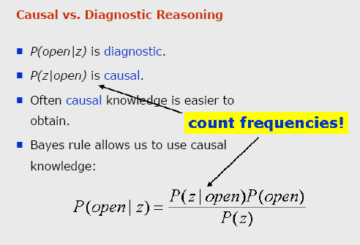

Slide 6
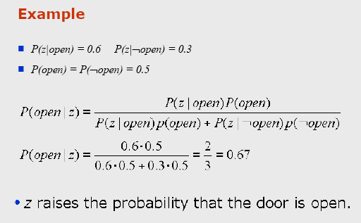

Slide 7
Naive Bayes Classification Algorithm
Naïve Bayes is a data-classification algorithm that is based on probabilistic analysis.
The term probability is often associated with the term event.
“The probability of Event X is so and so.”
The probability of Event X is a numerical value.
You can calculate this numerical value by dividing the number of times Event X can occur by the number of events that are possible in the same circumstances.

Slide 8
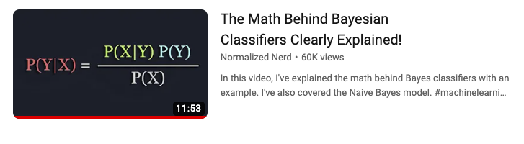
Video explaining Bayes theorem and Naïve Bayesian classifier
https://youtu.be/lFJbZ6LVxN8?si=za-ZWX0io3YHQhdi

Slide 9
Defining a Classification problem
Suppose we have feature X :
X= (x₁,x₂,……….,x_{n})
and we need correct label that is represented by :Y
where X & Y random variables.
Then,
P(Y=y| X= x₁,x₂,……….,x_{n}),
A conditional probability which finds the probability of Y is equal to y, given that X = x₁,x₂,……….,x_{n}
So, we need to find the value of y for which this conditional probability becomes maximum.

Slide 10

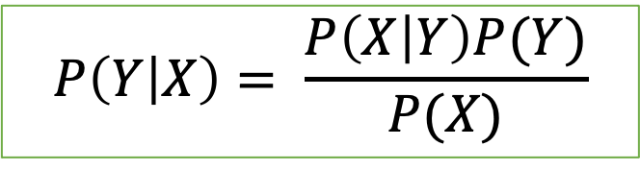
Bayes theorem
$$P\left(Y | X\right)= \frac{P\left(X | Y\right)P(Y)}{P(X)}$$
Posterior $= \frac{Likelihood ∗Prior}{Evidence}$
P(Y) Prior : probability before having any evidences.
P(X|Y) Likelihood : Probability of X happening for Y.
P(X) Evidence : Probability event happened
P(Y|X) Posterior: probability after having some evidences

Slide 11
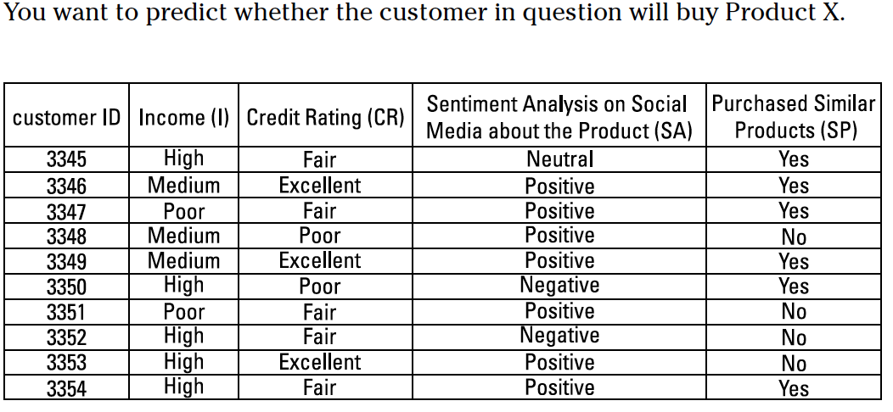
Example

Slide 12
Probabilities definitions and notations
P(X) is the probability of X being purchased.
P(not_X) is the probability of X not being purchased.
P(CR_fair|X) is the probability that a customer’s credit rating is fair and the customer purchases Product X.
P(CR_excellent|X) is the probability that a customer’s credit rating is excellent and the customer purchases Product X.
P(CR_poor|X) is the probability that a customer’s credit rating is poor and the customer purchases Product X.
P(CR_fair|not_X) is the probability that a customer’s credit rating is poor and the customer did not purchase Product X.
P(CR_excellent|not_X) is the probability that a customer’s credit rating is excellent and the customer did not purchase Product X.
P(CR_poor|not_X) is the probability that a customer’s credit rating is poor and the customer did not purchase Product X.

Slide 13
Probabilities definitions and notations
P(I_medium|X) is the probability that a customer’s income is medium and the customer did purchase Product X.
P(I_high|X) is the probability that a customer’s income is high and the customer did purchase Product X.
P(I_poor|X) is the probability that a customer’s income is poor and the customer did purchase Product X.
P(I_medium|not_X) is the probability that a customer’s income is medium and the customer did not purchase Product X.
P(I_high|not_X) is the probability that a customer’s income is high and the customer did not purchase Product X.
P(I_poor|not_X) is the probability that a customer’s income is poor and the customer did not purchase Product X.
P(SA_neutral|X) is the probability that a customer’s sentiment on social media is neutral about Product X and the customer did purchase Product X.
P(SA_positive|X) is the probability that a customer’s sentiment on social media is positive about Product X and the customer did purchase Product X.

Slide 14
Probability Evaluation
P(X) = 6/10 = 0.6
P(not_X) = 4/10 = 0.4
P(CR_fair|X) = 4/6 = 0.66
P(CR_excellent|X)=2/6 = 0.33
P(CR_poor|X)=0/6 = 0
P(CR_fair|not_X)= 1/4 = 0.25
P(CR_excellent|not_X)=1/4 = 0.25
P(CR_poor|not_X)=2/4 = 0.5
P(I_medium|X)=2/6 = 0.33
P(I_high|X)=3/6 = 0.5
P(I_poor|X)= 1/6 = 0.16
P(I_medium|not_X) = 1/4 = 0.25
P(I_high|not_X) = 2/4 = 0.5
P(I_poor|not_X) = 1/4 = 0.25
P(SA_neutral|X) =1/6 = 0.16
P(SA_positive|X)=4/6 = 0.66
P(SA_negative|X)=1/6 = 0.16
P(SA_neutral|not_X)=0/4 = 0
P(SA_positive|not_X)=3/4 = 0.75
P(SA_negative|not_X)=1/4 = 0.25
P(SP_yes|X)=4/6 = 0.66
P(SP_no|X)=2/6 = 0.33
P(SP_yes|not_X)=2/4 = 0.5
P(SP_no|not_X)=2/4 = 0.5

Slide 15
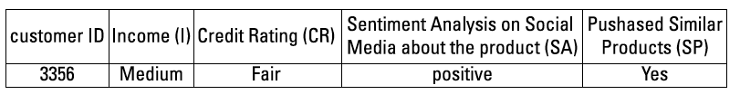
Customer- ID 3356 and who has the features(evidence)

Slide 16
Interpretation
You want to know whether the company should spend money on advertising Product X to this new customer.
In other words, you want to know the probability that the customer will purchase Product X.
The customer is of medium income, has a poor credit rating, has a positive sentiment analysis on social media about Product X, and has a history of purchasing similar products.
The classifier uses historical data (as shown in Figure 7-4) and Bayes’ Theorem (mentioned earlier in this section) to label the new customer as a potential buyer of Product X . . . or not.

Slide 17
Historical data and Bayes’ Theorem to label
The classifier uses historical data and Bayes’ Theorem to label the new customer as a potential buyer of Product X . . . or not.
Let P(X|Customer#3356) be the probability that Product X will be purchased by Customer#3356, given the customer’s features.
Let P(not_X|Customer#3356) be the probability that Product X will not be purchased by Customer#3356.
Following Bayes’ Theorem, the following probabilities can be calculated:
P (X|Customer#3356) =
[P(X) * P(Customer#3356|X)] / [P(X) * P(Customer#3356|X) + P (not-X) * P
(Customer#3356|not_X)]
P(not_X|Customer#3356) = [P(not_X) * P(Customer#3356|not_X)] /
[P (not_X) * P (Customer#3356|not-X) +P(X) * P(Customer#3356|X)]
Notice that those probabilities have the same denominator. Thus we focus on comparing the numerators, as follows:
P(Customer#3356|X) is the probability of having customers like Customer#3356, knowing that Customer#3356 purchased Product X.
P(Customer#3356|X) = P(CR_fair|X) * P(I_medium|X) * P(SA_positive|X) * P(SP_yes|X)
= 0.66 * 0.33 * 0.66 * 0.66 = 0.0948

Slide 18
Conclusions
Naïve Bayes based on the independence assumption
Training is very easy and fast; just requiring considering each attribute in each class separately
Test is straightforward; just looking up tables or calculating conditional probabilities with normal distributions
A popular generative model
Performance competitive to most of state-of-the-art classifiers even in presence of violating independence assumption
Many successful applications, e.g., spam mail filtering
Apart from classification, naïve Bayes can do more…

Slide 19

Neural networks
Classification

Slide 20
Neural networks
A more complex algorithm, biologically inspired by the structure of the human brain.
A neural network provides a very simple model in comparison to the human brain, but it works well enough for our purposes.
Widely used for data classification, neural networks process past and current data to estimate future values — discovering any complex correlations hidden in the data — in a way analogous to that employed by the human brain.
Neural networks can be used to make predictions on time series data such as weather data.
A neural network can be designed to detect pattern in input data and produce an output free of noise.

Slide 21

Video for brief explanation of Neural Network
https://youtu.be/bfmFfD2RIcg?si=lbGjoKEChMpLeaEU

Slide 22
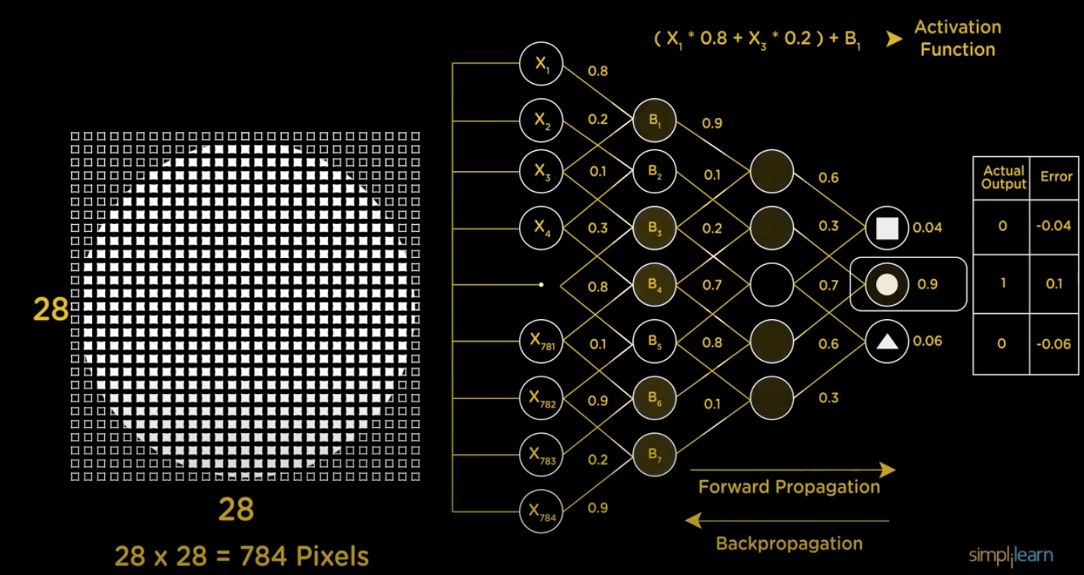

Slide 23
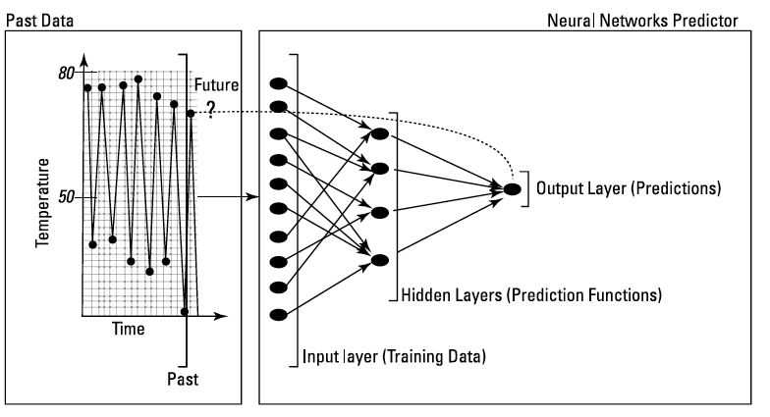
Structure of a neural-network algorithm

Slide 24
Structure of a neural-network algorithm
Input layer:
feeds past data values into the next (hidden) layer.
The black circles represent nodes of the neural network.
Hidden layer:
Encapsulates several complex functions that create predictors; functions are hidden from the user.
A set of nodes (black circles) at the hidden layer represents mathematical functions that modify the input data
these functions are called Neurons.
Output layer:
collects the predictions made in the hidden layer and produces the result:
the model’s prediction.

Slide 25
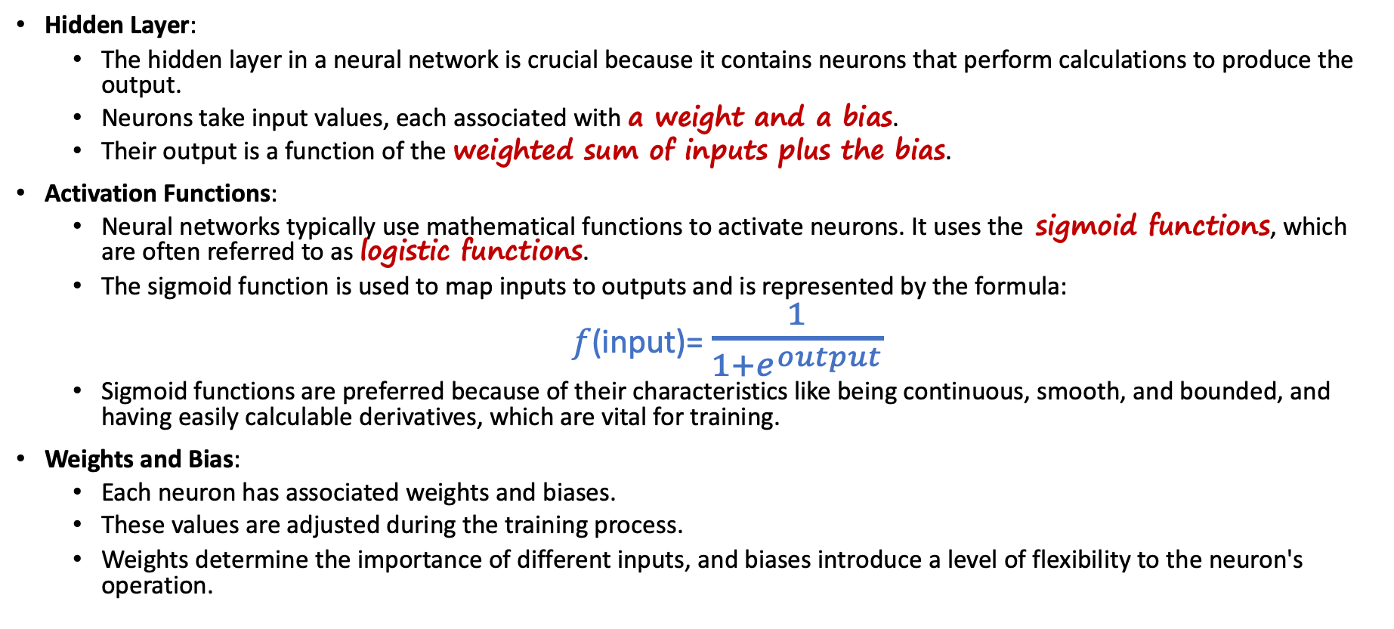
The Training process
Hidden Layer:
The hidden layer in a neural network is crucial because it contains neurons that perform calculations to produce the output.
Neurons take input values, each associated with a weight and a bias.
Their output is a function of the weighted sum of inputs plus the bias.
Activation Functions:
Neural networks typically use mathematical functions to activate neurons. It uses the sigmoid functions, which are often referred to as logistic functions.
The sigmoid function is used to map inputs to outputs and is represented by the formula:
$f\text{(}\text{input}\text{)}$= $\frac{1}{1+e^{output}}$
Sigmoid functions are preferred because of their characteristics like being continuous, smooth, and bounded, and having easily calculable derivatives, which are vital for training.
Weights and Bias:
Each neuron has associated weights and biases.
These values are adjusted during the training process.
Weights determine the importance of different inputs, and biases introduce a level of flexibility to the neuron's operation.

Slide 26
The Training process Neural networks are trained using either supervised or unsupervised methods
Supervised Training:
Weights are derived by providing the network with sample inputs and their corresponding outputs until the weights are tuned to achieve a close match between inputs and outputs.
This process is used for tasks like classification and regression.
Unsupervised Training:
The network is only given inputs, and the algorithm generates corresponding outputs.
When the algorithm can produce new outputs for new, similar inputs that are in line with previous outputs, it indicates that the weights have been tuned.
Unsupervised training is often used for tasks like clustering or feature learning.

Slide 27
The Training process
Advantages
Neural networks have the advantage of being able to work well even when the data contains a significant amount of noise.
This means they can discover relationships in the data despite some inaccuracies or variability.
This ability to generalize is a key strength of neural networks.
Disadvantage:
The accuracy of neural network predictions may be valid only within the time period during which the training data was gathered.
This is known as the issue of data stationarity.
Neural networks might not perform as well when applied to data outside the time they were trained on because the underlying patterns in the data may change.

Slide 28

The Markov Model
Markov chain

Slide 29
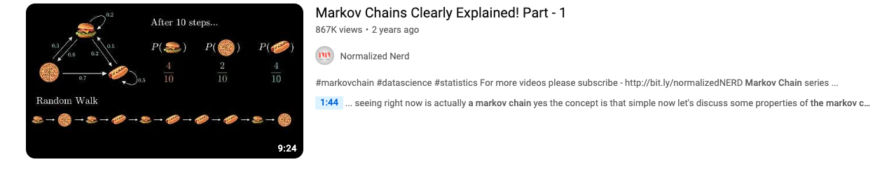
Video to Explain Markov chain
https://youtu.be/i3AkTO9HLXo?si=0cd5U6ac50dwpeS3

Slide 30
Markov Assumption
Probabilistic predictions based on historical events.
The Markov Model is a statistical model heavily reliant on probability theory.
The probability of n+1th step will be x will only depend upon n^{th} step not whole sequence o step
P(X_{n+1} =x) | X_{n} =x_{n}
It's named after a Russian mathematician known for his work in probability theory.
Scenario:
Let's say you want to predict whether Team X (a soccer team) will win tomorrow's game.
You have access to the outcomes of the last 10 games Team X played.

Slide 31
Markov Assumption
The Markov Assumption simplifies probability calculations for predicting future events.
It states that the probability of an event occurring, given n past events, is approximately equal to the probability of that event happening given only the most recent past event.
Written as a formula:
P(event_t | event_t-1, event_t-2, ..., event_n) ≈ P(event_t | event_t-1)
In simpler terms, you don't need to consider a long history of events; you can focus on the most recent one.

Slide 32
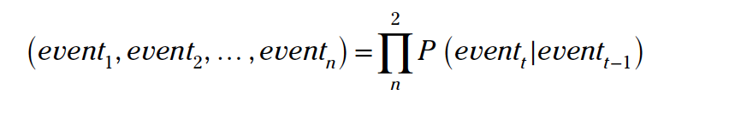
Sequence Probability Calculation:
First-Order Markov Prediction:
When you use only the last event to predict the future event, it's called first-order Markov prediction.
This means you consider just the last event in the sequence.
Second-Order Markov Prediction:
A second-order Markov prediction includes the last two events in the sequence.
Sequence Probability Calculation:
The equation provided aims to calculate the probability of a sequence of events occurring in order, such as event1 after event2, and so on.
The probability of each event_t (given the previous event) is multiplied by the probability of the next event in the sequence.
EXAMPLE:
If you want to predict the probability of Team X winning, then losing, and then tying, you would calculate it by multiplying the probability of winning (given the previous outcome), the probability of losing (given the previous outcome), and the probability of tying (given the previous outcome).

Slide 33
A typical Markov Model prediction
Suppose you want to predict the results of a soccer game to be played by Team X.
The three possible outcomes — called states — are win, loss, or tie.
Assume that you’ve collected past statistical data on the results of Team X’s soccer games, and that Team X lost its most recent game.
You want to predict the outcome of the next soccer game.
It’s all about guessing whether Team X will win, lose, or tie — relying only on data from past games.

Slide 34
A typical Markov Model prediction
Calculating Probabilities Based on Past Data:
Collect data on Team X's past game outcomes (win, loss, tie).
Calculate probabilities of winning, losing, and tying based on the historical data.
Using Naïve Bayes Probability Equation:
Employ the probability equation from Naïve Bayes to calculate probabilities such as:
Probability of Team X winning, given that Team X lost the last game.
Probability of Team X losing, given that Team X won the last game.
Calculating Probabilities for Each State:
Determine probabilities for different sequences of states (win, loss, tie) based on past transitions.
Calculate conditional probabilities like:
P(Win|Loss) - Probability that Team X will win today given that it lost yesterday.
P(Win|Tie) - Probability that Team X will win today given that it tied yesterday.
)P(Win|Win) - Probability that Team X will win today given that it won yesterday.

Slide 35

A typical Markov Model prediction
Calculate some probabilities based on past data.
How many times has Team X lost games?
How many times has Team X won games?
For example, imagine if Team X won 6 games out of ten games in total. In other words, the probability of wining for Team X is 60 percent.
You arrive at this figure by taking the number of victories and dividing by 10 (the total number of games), which results in a probability of 60 percent.
Calculate the probability of a loss, and then the probability of a tie, in the same way.
Use the probability equation mentioned in the previous Naïve Bayes section to calculate probabilities such as the following:
The probability that Team X will win, given that Team X lost the last game.
The probability that Team X will lose, given that Team X won the last game.

Slide 36
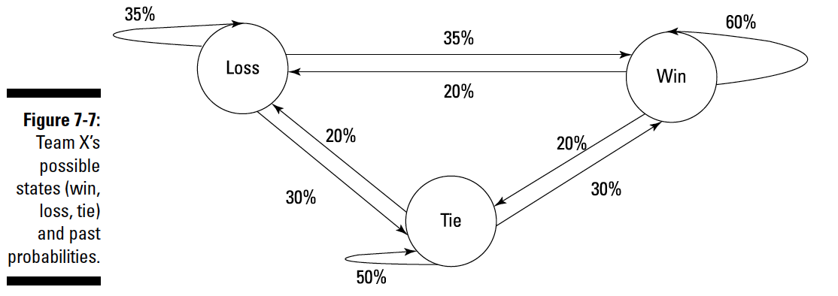
A typical Markov Model prediction

Slide 37
Calculated Probabilities
Using the calculated probabilities, create a chart like the one shown in Figure 7-7.
A circle in this chart represents a possible state that Team X could attain at any given time (win, loss, tie)
the numbers on the arrows represent the probabilities that Team X could move from one state to another.
If Team X has just won today’s game (its current state = win)
The probability that the team will win again is 60 percent;
the probability that they’ll lose the next game is 20 percent
they’d move from current state = win to future state = loss

Slide 38
Using hidden Markov Models
A hidden Markov Model is a Markov Model in which a previous state from which the current state originated can be hidden or unknown.
The main inputs to the model are the states transition probabilities and a number of observations.
A hidden Markov Model takes observation states into consideration.
For example, predicting a future state based on a previous state and some observations.
Suppose you’re currently watching a game that Team X is playing, and you make the following observation:
Team X is winning, so far, by 1 goal to zero (the current score over the first 30 minutes of the game).
Based on only one present observation, you want to predict a hidden future state: Will Team X win, lose, or tie?

Slide 39
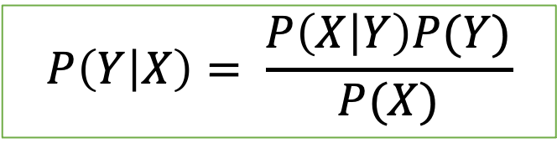
Hidden Markov Models
Notations:
X: event_{t}=future =
win (Future event - Team X winning)
Y: event_{t}−1 =
tie (Past event - Team X tying in the last game)
Z: observation =
scored a goal in the first 30 minutes
Using Bayes' Theorem and applying the Markov Assumption:
$$P\left(Y | X\right)= \frac{P\left(X | Y\right)P(Y)}{P(X)}$$

Slide 40
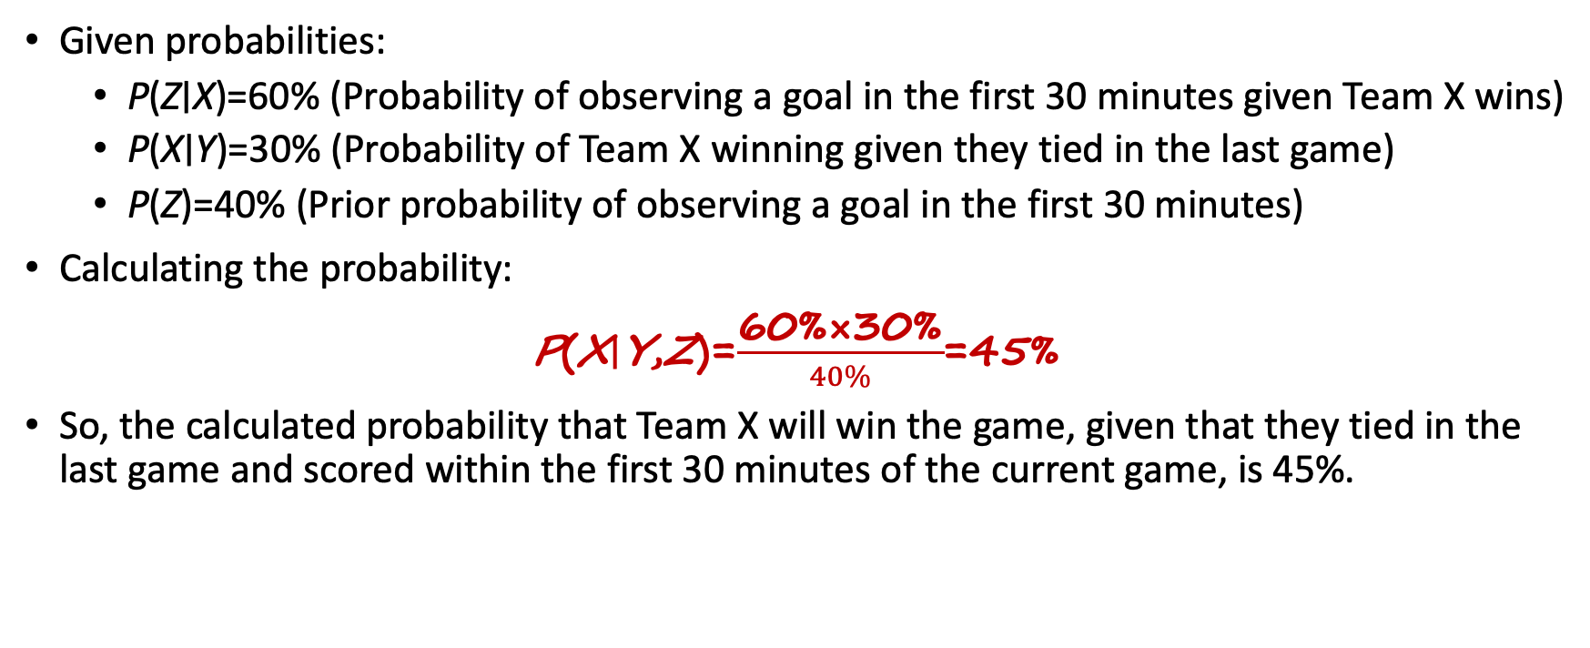
Hidden Markov Models
Given probabilities:
P(Z∣X)=60% (Probability of observing a goal in the first 30 minutes given Team X wins)
P(X∣Y)=30% (Probability of Team X winning given they tied in the last game)
P(Z)=40% (Prior probability of observing a goal in the first 30 minutes)
Calculating the probability:
P(X∣Y,Z)=$\frac{\text{60\%}\text{×}\text{30\%​}}{40\%}$=45%
So, the calculated probability that Team X will win the game, given that they tied in the last game and scored within the first 30 minutes of the current game, is 45%.

Slide 41
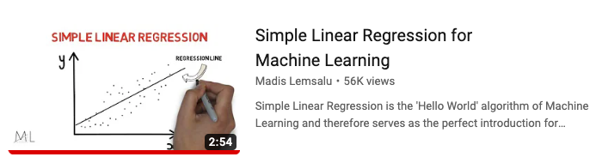
Linear regression
https://youtu.be/HoqXask9cN8?si=jSME98vzIY8uXFOf

Slide 42
Linear regression
Linear regression aims to find the relationship between two variables.
For the given example of train arrival times and delay times, the linear regression equation is depicted as:
Delay=a+(b× Arrival time)+d
Here, 'Delay' represents the dependent variable (the variable to be predicted), 'Arrival time' is the independent variable, and 'a', 'b', and 'd' are the model parameters.
'd' signifies the error term or the discrepancy between the predicted delay and the actual delay not accounted for by the model.

Slide 43
Linear regression
Predictive Usage of Linear Regression:
By having the parameters 'a', 'b', and 'd' calculated from the linear regression model using past data, it becomes feasible to predict the expected delay for the next train by inputting the arrival time into the equation.
Sensitivity to Outliers:
Outliers, which are extreme or unusual data points, can significantly impact the linear regression model's accuracy and bias its results.
It's recommended to identify and handle outliers appropriately, such as by removing them from the training dataset, to improve the model's performance.

Slide 44
Ensemble Methods to Boost Prediction Accuracy
Ensemble methods in machine learning involve combining multiple individual models to improve overall predictive performance.
One popular ensemble technique is the voting mechanism, where the predictions of multiple models are aggregated to make a final decision.

Slide 45

Ensemble Methods to Boost Prediction Accuracy
Training Phase:
The training data is divided into several subsets.
Each individual model (base learner) within the ensemble is trained on a different subset of the data or using different techniques (e.g., different algorithms, variations in data, etc.).
These models learn patterns and relationships within their respective subsets or using their specific methodologies.
Prediction Phase:
When new, unseen data needs to be predicted, it is passed through all the trained models in the ensemble.
Each model predicts a class label or makes a prediction based on its learned patterns from the training phase.
Aggregation of Predictions:
After obtaining predictions from each model, an aggregation strategy is employed to derive the final prediction.
A common technique is the voting mechanism, where the final prediction is determined by the majority vote among the predictions made by individual models.
For classification tasks, the class label predicted by the majority of models becomes the overall prediction of the ensemble model.
In some cases, weighted voting might be used where the confidence or performance of each model influences its vote.

Slide 46
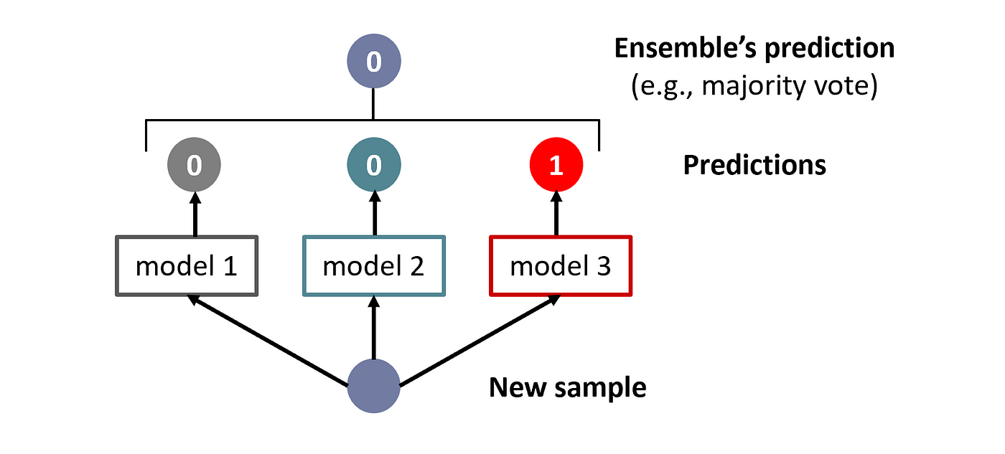
Ensemble Methods to Boost Prediction Accuracy

